Slide 1
AAI-590 Capstone Project - Group 2
Credit Card Fraud Detection Using Machine Learning Techniques
Masters Program in AAI, University of San Diego
Team Members - Angshuman Roy , Harish Acharya , Sandeep Kumar Jakkaraju
Zahid Wani (Instructor)

Slide 2
Agenda / Overview
Project motivation
Dataset summary
Exploratory Data Analysis (EDA)
Machine learning approaches
Experimental setup
Model performance comparison
ROC, PR curves & confusion matrix
Hypothesis evaluation
Limitations and future work

Slide 3
Project motivation
    Credit card fraud causes billions of dollars in annual global financial losses.
    Fraudulent transactions erode customer trust and damage brand reputation.
    Traditional rule-based fraud systems struggle to detect new or evolving fraud patterns.
    Payment ecosystems are experiencing increased transaction volume and complexity.
    Fraudsters adapt quickly, requiring dynamic and intelligent detection methods.
    Extremely imbalanced data (<0.2% fraud) makes accurate detection highly challenging.
    High false positives result in customer friction and operational overhead.
    High false negatives lead directly to financial loss and regulatory exposure.
    Machine learning models can learn complex behavioral patterns beyond rule engines.
    Ensemble models and deep learning offer state-of-the-art performance for tabular fraud data.
    Automated fraud detection reduces manual review burden for fraud analysts.
    Real-time ML approaches improve decision speed and reduce blocked legitimate payments.
    Identifying the best model enables scalable deployment across financial systems.
    Goal: Determine which ML methods yield the best precision–recall balance for real-world fraud detection.

Slide 4
Dataset summary
Dataset Source : The dataset used in this project is the Credit Card Fraud Detection Dataset hosted on Kaggle. Kaggle URL: https://www.kaggle.com/datasets/mlg-ulb/creditcardfraud
Dataset Description
    The dataset contains anonymized credit card transactions made by EU cardholders in Sep 2013.
    There are 284,807 total transactions, of which only 492 are fraudulent.
    Fraud cases represent 0.172% of all transactions, creating an extreme class imbalance that makes this problem especially challenging.
    The dataset includes 30 input features plus one target label:
      PCA-Transformed Features (V1–V28)
      Due to confidentiality concerns, most features are transformed using Principal Component Analysis. These are labeled V1 through V28.
      PCA ensures anonymity but reduces interpretability.
      PCA lowers multicollinearity, making the data suitable for linear and nonlinear ML models.

Slide 5
Dataset summary – contd.
Original Features
    Time: Seconds elapsed between each transaction and the first transaction in the dataset.
    Amount: Transaction amount (useful for cost-sensitive analysis).
Target Variable
      Class:
        0 → Legitimate transaction
        1 → Fraudulent transaction

Slide 6
Exploratory Data Analysis (EDA)
    Dataset contains 284,807 transactions with only 0.172% fraud cases
    PCA-transformed variables (V1–V28) reduce interpretability but lower correlation
    Fraud transactions show distinct distributions in V17, V14, V12, V10, and V16
    Transaction Amount is heavily right-skewed → scaling improves model stability
    No strong seasonal pattern in Time feature
    Correlation heatmap shows near-zero multicollinearity
    Fraud class separation visible in feature density plots
    Confirms suitability of boosted trees and DNN for pattern extraction
    Fraudulent transactions tend to have lower median transaction amounts compared to legitimate ones.
    Several PCA components (e.g., V4, V11, V18) show subtle but meaningful distribution shifts for fraud cases.
    Fraud cases appear more scattered across the PCA-transformed feature space rather than forming tight clusters.
    The Time feature does not strongly differentiate fraud vs. non-fraud but shows periodic peaks in activity volume.

Slide 7
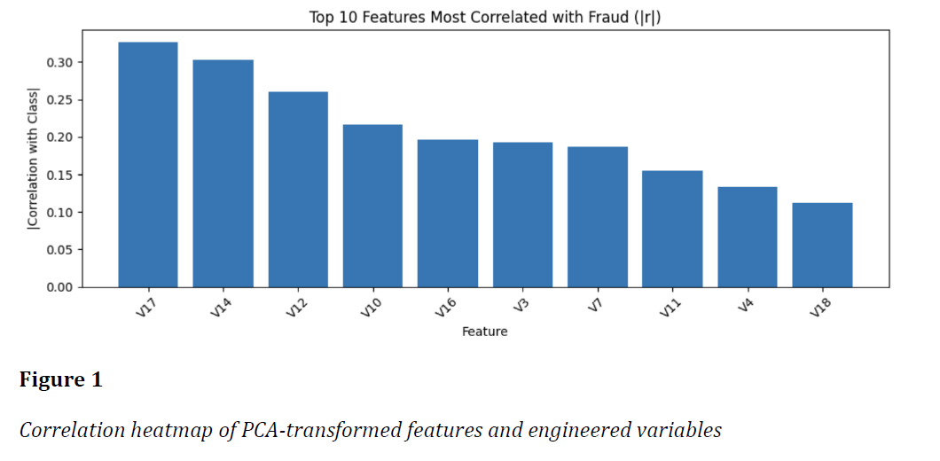
Exploratory Data Analysis (EDA) – contd.
  Above Figure shows the top 10 features most correlated with the fraud label.
  PCA components V17, V14, V12, V10 exhibit the strongest correlations with fraudulent transactions.
  These features capture hidden behavioral or transactional patterns associated with fraud.
  High-magnitude PCA components indicate that certain latent dimensions are especially informative for anomaly detection.
  The correlation ranking helps identify which features contribute most to fraud prediction.

Slide 8
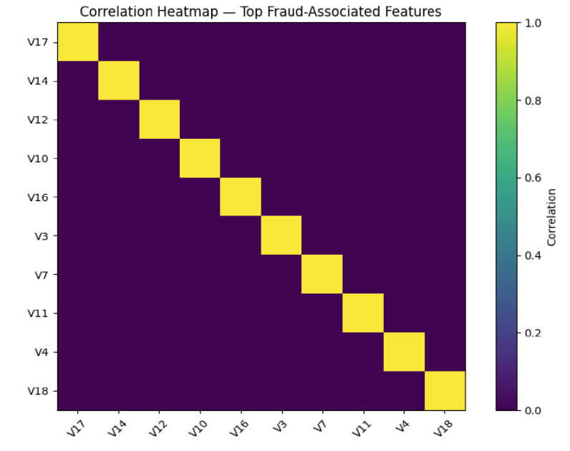
Exploratory Data Analysis (EDA) – contd.
  Above Figure shows that the top fraud-associated PCA components which have minimal pairwise correlation, confirming PCA’s orthogonality.
  Low intercorrelation indicates that each feature contributes unique information, helping models learn fraud patterns more effectively.
  The correlation ranking helps identify which features contribute most to fraud prediction.

Slide 9
Machine Learning Approaches
    Classical Models: Logistic Regression, Linear SVM, Naive Bayes, k-NN
    Ensemble Models: Random Forest, XGBoost, LightGBM, CatBoost
    Deep Learning: Feedforward DNN with ReLU + Sigmoid activation
    Anomaly Detection: Isolation Forest, Local Outlier Factor (LOF), Autoencoder
    Methods chosen to compare linear, nonlinear, deep, and unsupervised paradigms
    Goal: Identify strongest model under extreme class imbalance
    Evaluate trade-offs between recall (fraud detection) and precision (false alarms)

Slide 10
Experimental Setup
    Dataset split: 70% train, 15% validation, 15% test
    StandardScaler applied to Time and Amount
    SMOTE oversampling used for classical & tree models
    Class weights applied for DNN training
    DNN architecture: 32 → 16 → 8 → 1 with early stopping
    Boosted tree models tuned with learning rate, depth, estimators
    Evaluation metrics: Accuracy, Precision, Recall, F1, ROC–AUC, PR–AUC
    Goal: maximize recall while keeping false positives low

Slide 11
Model Performance Comparison
    Top Performer: LightGBM → Best F1-score (0.8382), high precision (0.9194)
    Highest ROC–AUC: XGBoost (0.9797), consistently strong across metrics
    DNN: Competitive nonlinear model with stable training behavior
    Random Forest: High precision but moderate recall
    k-NN: Extremely high accuracy but weak fraud recall
    Logistic Regression & SVM: Limited by linear decision boundaries
    Naive Bayes: Lowest precision and recall among supervised models
    Unsupervised models performed poorly: high false positives or low recall

Slide 12
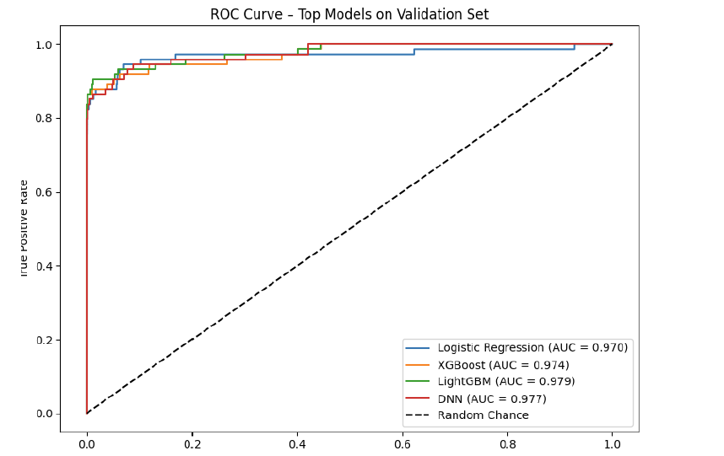
ROC, PR Curves & Confusion Matrix
ROC Curve
  LightGBM, XGBoost, and DNN show near-perfect ROC curves ,ROC–AUC values > 0.97 indicate strong separation power
  Logistic Regression trails behind nonlinear models

Slide 13
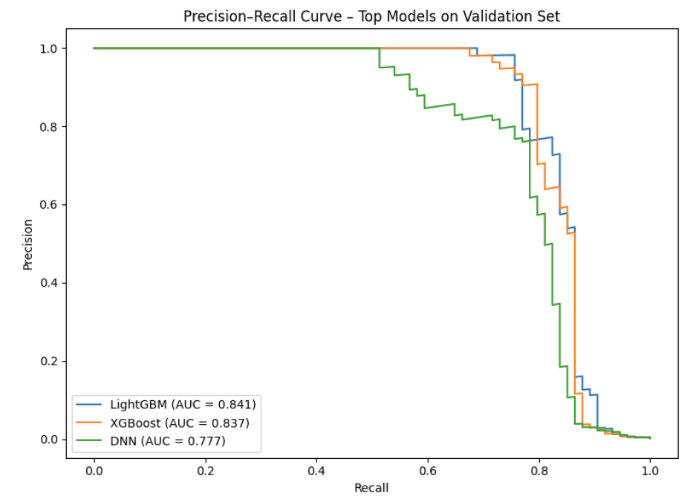
ROC, PR Curves & Confusion Matrix – contd.
Precision–Recall Curve
  LightGBM maintains highest precision across recall thresholds
  PR curves highlight severe class imbalance more effectively
  DNN drops precision faster at high recall

Slide 14
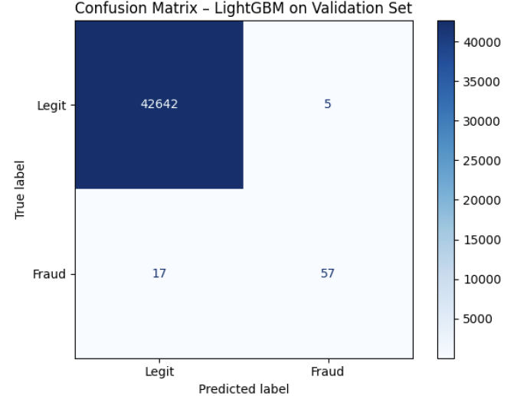
ROC, PR Curves & Confusion Matrix – contd.
Confusion Matrix (LightGBM)
  True Positives: 57
  False Negatives: 17
  True Negatives: 42,642
  False Positives: 5
  Extremely low false-positive rate → highly operationally viable

Slide 15
Hypothesis Evaluation
  Hypothesis: Boosted tree models and DNN will outperform classical and anomaly-based methods
  Supported by results:
      LightGBM: Best F1-score and precision
      XGBoost: Highest ROC–AUC
      DNN: Strong nonlinear performance
  Classical models underperform due to linear boundaries
  Anomaly detection ineffective because fraud does not form a distinct PCA cluster
  Conclusion: Boosted ensemble models + DNN provide best fraud detection capability

Slide 16
Limitations and Future Work
Limitations
    PCA transformation limits interpretability
    Class imbalance still produces false negatives
    Thresholds not optimized for operational cost
    DNN tuning limited by compute and time constraints
    Dataset is from 2013 → may not reflect modern fraud behavior
Future Work
    Cost-sensitive threshold tuning to minimize financial loss
    Hyperparameter optimization using Bayesian or Optuna search
    Real-time detection pipeline using streaming systems (Kafka, Flink)
    Feature engineering with domain knowledge for improved interpretability

Slide 17
Limitations and Future Work – contd.
Future Work
    Model stacking (LightGBM + DNN) for improved recall
    Incorporate time-series or sequence-based models (LSTM, Transformers)
    Real-time detection pipeline using streaming systems (Kafka, Flink)
    Feature engineering with domain knowledge for improved interpretability

Slide 18
Thank You

